Slide 1
Subroutines and Control Abstraction
Sabrina Tarin Chowdhury

Slide 2
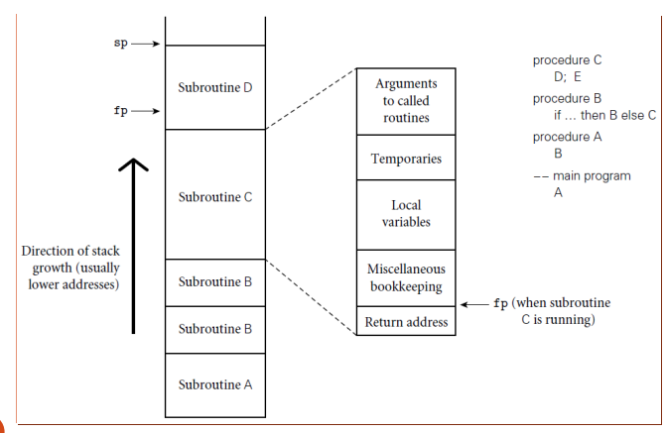
Review Of Stack Layout
Stack recap: Each routine, as called, gets a new frame put on the top of the stack
Contains arguments, return values, book-keeping info, local variables, and temporaries
Stack pointer: the address of either:
last used location at the top of the stack
First unused location
Frame pointer: address within the frame
Objects in the frame are accessed via offset from the frame pointer
Variable size things are towards top of the frame, since can’t be preset, with dope in fixed size part

Slide 3
Calling Sequences
The calling sequence is the code a caller executes to set up a new subroutine
Responsibilities:
On the way in to the subroutine:
Pass parameters
save return address
change program counter
change stack pointer
save registers that might be overwritten
changing frame pointer to new frame
initializing code for new objects in the new frame

Slide 4
Calling Sequences
The calling sequence is the code a caller executes to set up a new subroutine
Responsibilities:
On the way out of the subroutine :
passing return parameters/values
executing finalization code for local objects
deallocating the stack frame
restoring registers
restoring the program counter

Slide 5
Calling Sequence
A function's prolog establishes a stack frame, if necessary, and may save any nonvolatile registers it uses. A function's epilog generally restores registers that were saved in the prolog code, restores the previous stack frame, and returns to the caller.
Note: some of these things must be done by caller! They differ from call to call.
Others, however, can be done by either caller or by prolog/epilog of callee.
In general, space is saved if work is mostly done by callee:
Anything done in callee appears only once in the target program
Anything done by caller has to appear before and after every call in the final compiled code

Slide 6
Calling Sequences (C on MIPS)
MIPS (Microprocessor without Interlocked Pipelined Stages) is a family of reduced instruction set computer (RISC) instruction set architectures
In prolog, Callee
subtracts framesize from sp
saves callee-saves registers used anywhere inside callee
copies sp to fp
In epilog, Callee
puts return value into registers (mem if large)
copies fp into sp (see below for rationale)
restores saved registers using sp as base
adds to sp to deallocate frame

Slide 7
Calling Sequences (C on MIPS)
After call, Caller
moves return value from register to wherever it's needed (if appropriate)
restores caller-saves registers lazily over time, as their values are needed
All arguments have space in the stack, whether passed in registers or not
The subroutine just begins with some of the arguments already cached in registers, and 'stale' values in memory
This is a normal state of affairs (especially in RISC); optimizing compilers keep things in registers whenever possible, flushing to memory only when they run out of registers, or when code may attempt to access the data through a pointer or from an inner scope

Slide 8
Calling Sequence
Perhaps trickiest bit is who saves registers.
Ideally, save only those that are in use in the caller and which would be overwritten in callee.
This is almost impossible to do perfectly.
Simplest solution is either to save all registers in use (from caller) or save all registers that will be overwritten (from callee).
However, this is usually a bit unnecessary – want to avoid extra overhead in general.

Slide 9
Calling Sequence
A balance exists on many processors (MIPS and x86, among others):
Two sets: caller responsibility and callee responsibility.
Callee can assume that there is nothing of value in any of the caller saved register set.
Caller can assume no callee will destroy contents in any of the callee-saves set.
Compiler will then use callee-saves registers for local variables and other long-lived ones if possible, and caller-saves set for transient values, which won’t be needed across calls.

Slide 10
RISC vs CISC
It is worth noting something about RISC architecture:
Heavily optimized to support simple instructions, so that every operation takes one clock cycle
Advantage is that pipelining is much easier in this setup
Each command also requires less transistors of hardware space
In contrast, CISC architecture:
Supports more complex operations: multiplication as well as add
Advantage is that code size is much smaller, so less RAM needed
In addition, less complexity in compiler

Slide 11
Parameters…
Formal parameters are in the subprogram definition
Actual parameters are the parameters passed to the subprogram
def example1(int a, int b) //formal params
…
end
example1(3, 4); //actual params
When mapped by position, called positional parameters

Slide 12
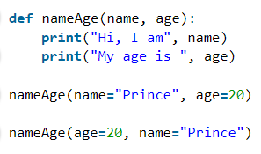
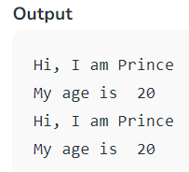
Parameters…
Python Example
When param list is long, positional parameters can lead to errors
Another approach is to use keyword parameters
Then params don’t need to match by position
Supported in Ada, C# 4.0+, Common Lisp, Fortran, Python,R, PHP, Ruby, Scala, Smalltalk, Swift
def example2(a , b )
…
end
example2(b = 5, a = 6)

Slide 13
Parameters…
Can mix and match although after a keyword param appears in the list, all other params have to be keyworded
def example3(a = myA, b = myB, c = myC)
…
end
example3(7, c = 8, b = 9)

Slide 14
Default parameters
Allowed in Python, Ruby, C++, PHP
If no actual parameter is passed, a default value is used
def example4(a, b = 1, c)
…
end
example4(10, c = 11)

Slide 15
Parameter Passing
Parameter passing mechanisms have three basic implementations
value
reference (aliasing)
closure/name
C/C++: functions
parameters passed by value (C)
parameters passed by reference can be simulated with pointers (C)
void proc(int* x,int y){*x = *x+y } …
proc(&a,b);
or directly passed by reference (C++)
void proc(int& x, int y) {x = x + y }
proc(a,b);

Slide 16
Parameter Passing
Passing by reference really gives two advantages:
Allows callee to change something and have it persist
Saves space/time copying
Unfortunately, the second isn’t really good in many cases – leads to buggy code, where changes are made that should not be allowed
Hence, use of read only parameters: READONLY in Modula
In C/C++, use const the same way

Slide 17
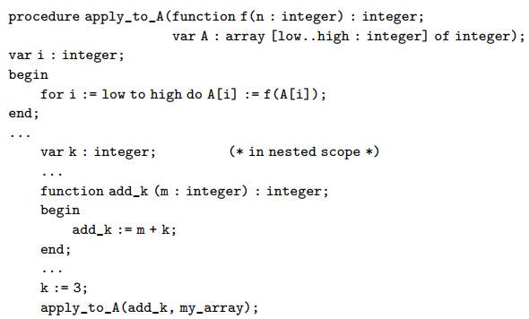

Parameter Passing
The last option is closures: a reference to a subroutine, together with its referencing environment
Goal: whenever that function is called, want access to its referencing environment
Example: a function that takes a function as input
Pascal
C++

Slide 18
Exception Handling
What is an exception?
a hardware-detected run-time error or unusual condition detected by software
Examples
arithmetic overflow
end-of-file on input
wrong type for input data
user-defined conditions, not necessarily errors

Slide 19
Exception Handling
Generally, we need the language to “unwind the stack” when exceptions happen
Basically, 3 options:
Invent a value that can be used by caller when the real one can’t be returned.
NO! Not good in general
Return an explicit status value to caller, which must be inspected after every call.
Clunky and annoying. Also a source of common bugs, since many programmers forget or choose not to do this.
Relay on the caller to pass a closure for error handling.
Also clutters, and only works in more functional languages.

Slide 20
Exception Handling
What is an exception handler?
code executed when exception occurs
may need a different handler for each type of exception
Why design in exception handling facilities?
allow user to explicitly handle errors in a uniform manner
allow user to handle errors without having to check these conditions
explicitly in the program everywhere they might occur

Slide 21
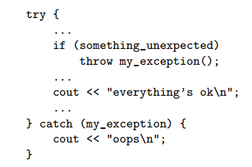
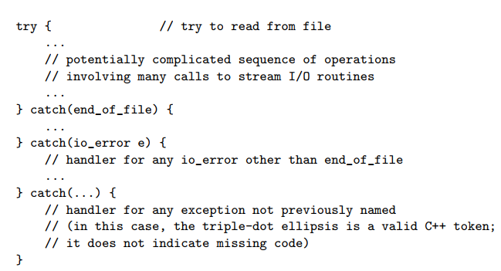
Exception Handling
Examples:
Try-catch in C++

Slide 22
Exception Handling
If the exception is not handled in the calling routine, it is handed back up the dynamic chain.
If not handled in the main routine, then a predefined outermost handler usually just kills the program.
Usually 3 goals:
Compensate if possible in order to continue execution.
Declare a local handler to clean up local resources and then reraise execution in order to pass along up the chain, where hopefully recovery can happen.
Print some sort of error if recovery is not possible.

Slide 23
Exception Handling
Defining is a mix:
In C++ or Lisp, all are programmer defined
In PHP, set_error_handler can be used to turn semantic errors into ordinary exceptions
In Ada, exception is a built-in type, and so you can easily make your own:
declare empty_queue : exception;
In Modula-3, exceptions are just another object, like constants or variables
Most languages allow a throw or raise in an if to raise an exception

